Slide 1

Word Vectors
신 병 주
bjshin@sejong.ac.kr
2018년 1월 9일

Slide 2
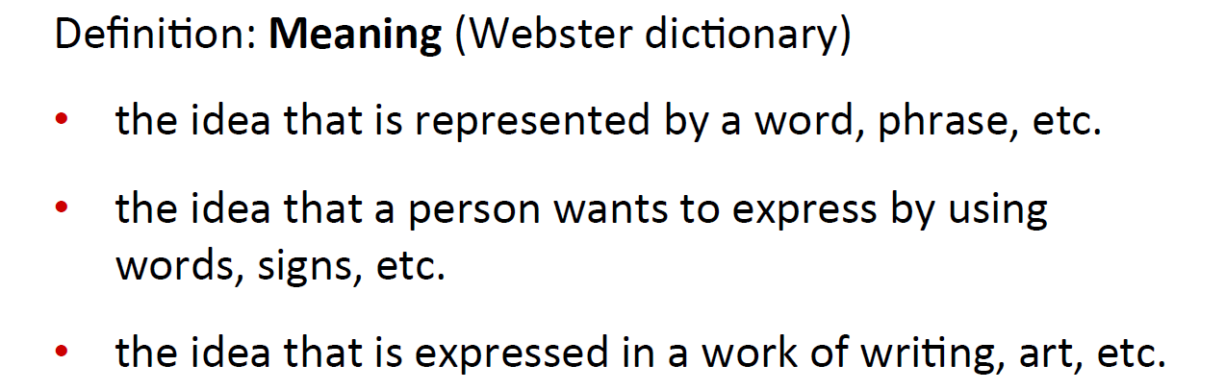
How do we represent the meaning of a word?

Slide 3
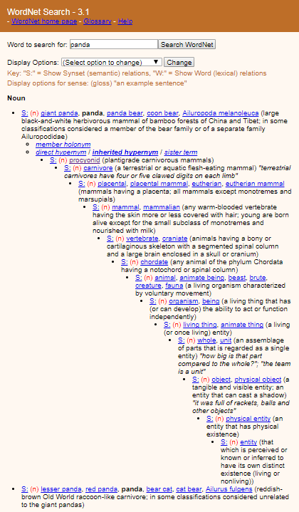
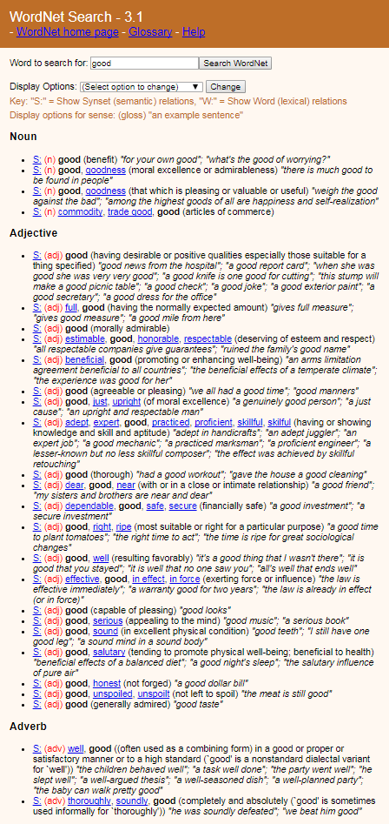
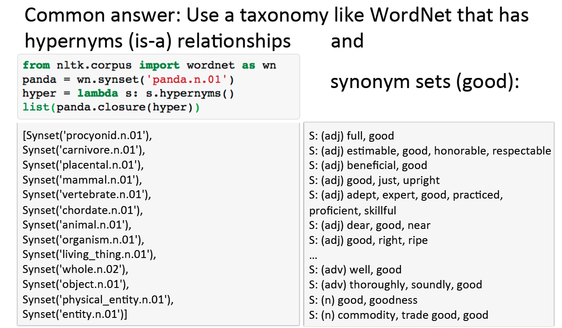
How to represent meaning in a computer?

Slide 4
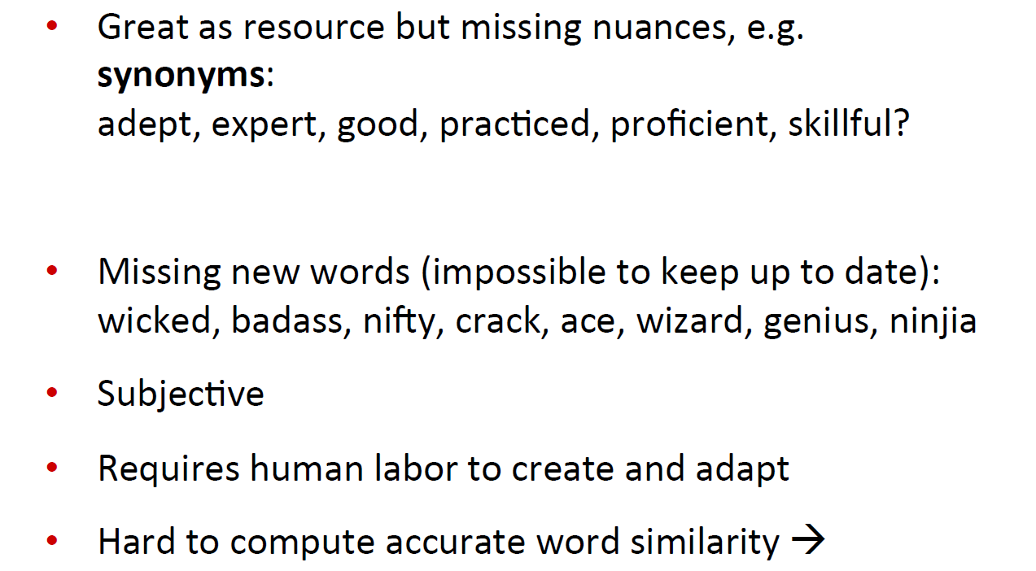
Problems with this discrete representation

Slide 5
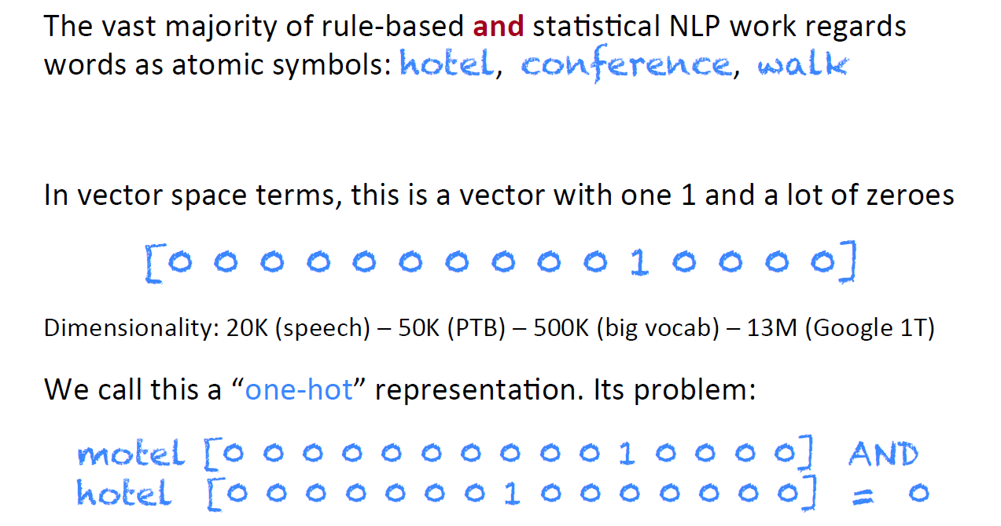
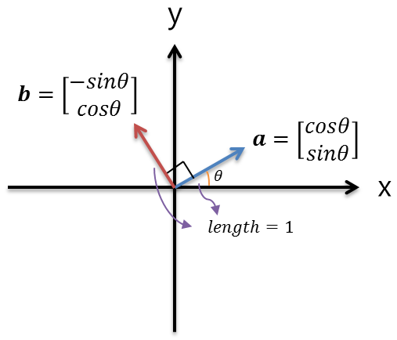
Problems with this discrete representation

Slide 6
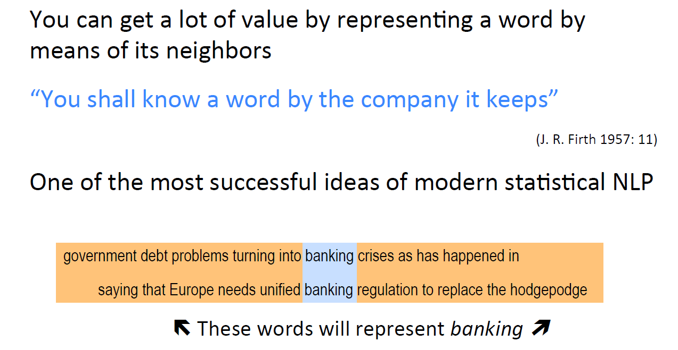
Distributional similartity based representations

Slide 7
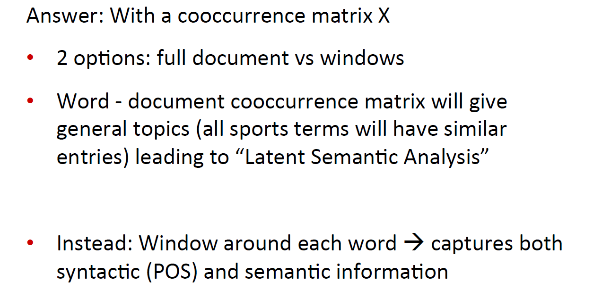
How to make neighbors represent words?

Slide 8
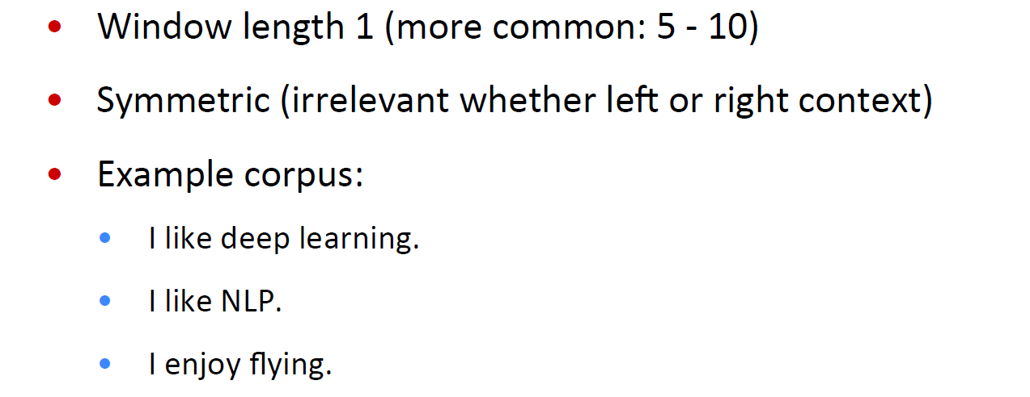
Window based cooccurence matrix

Slide 9
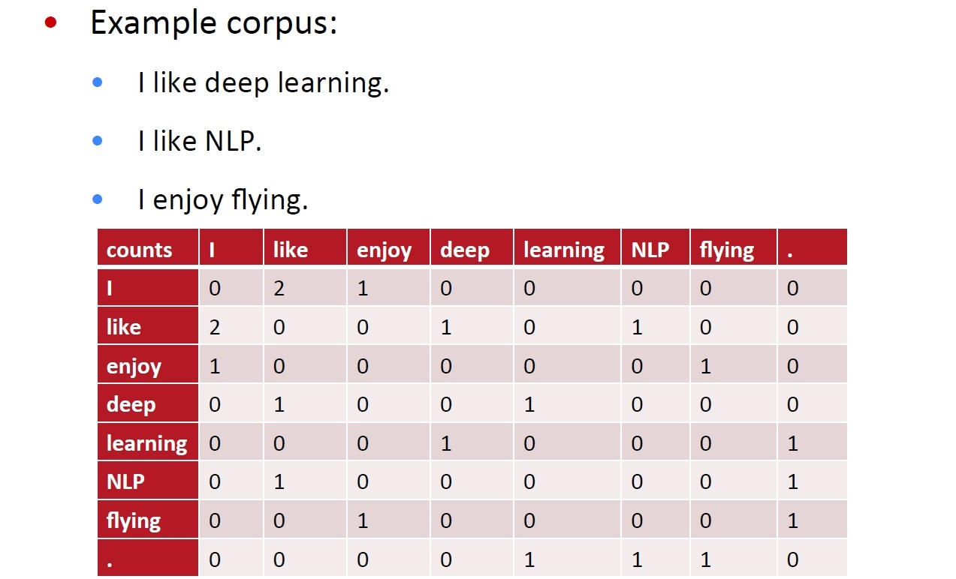
Window based cooccurence matrix

Slide 10
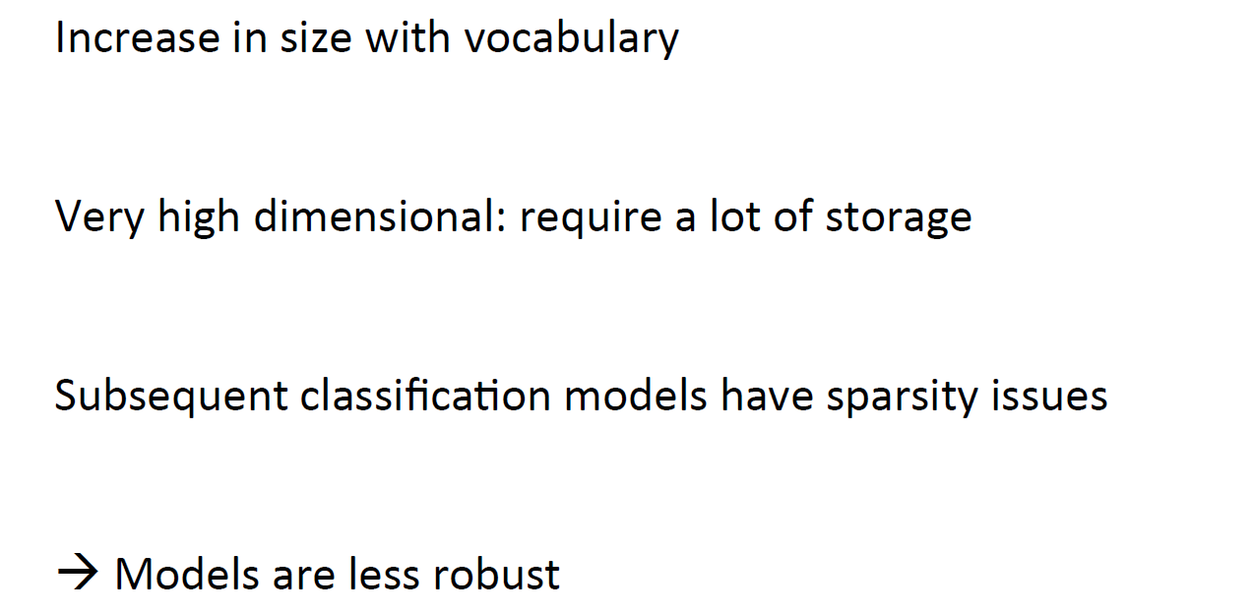
Problems with simple cooccurrence vectors

Slide 11
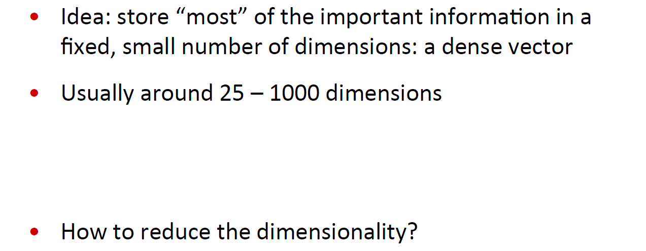
Solution: Low dimensional vectors
SVD( Singular Value Decomposition)

Slide 12
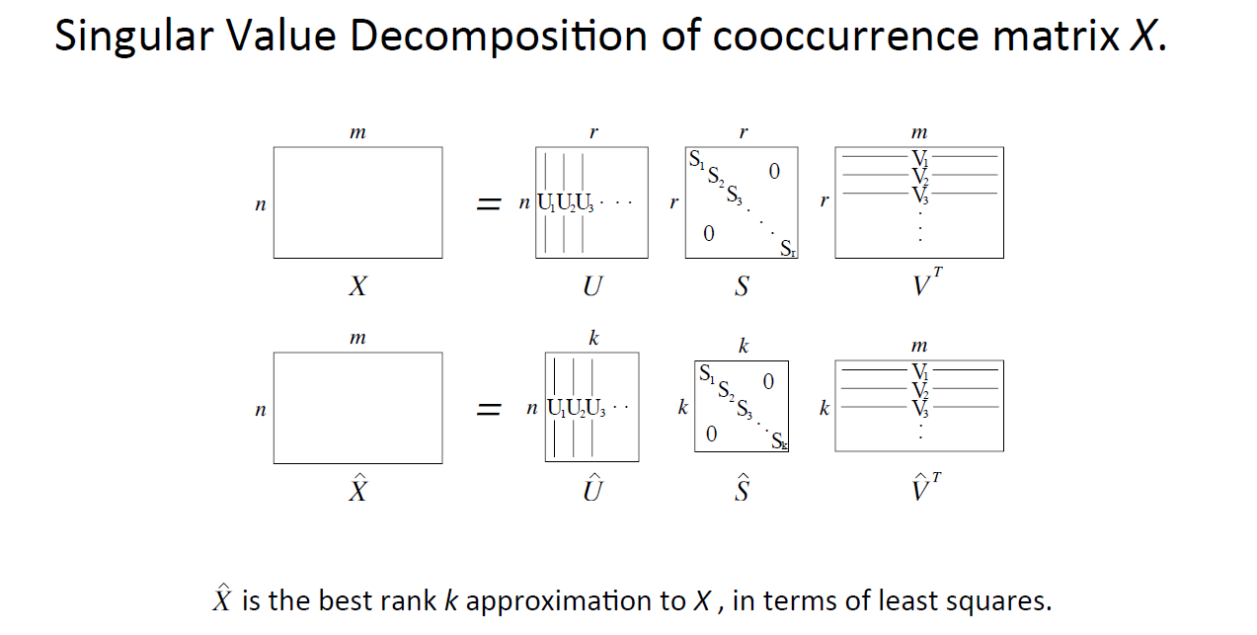
Method 1: Dimensionality Reduction on X

Slide 13
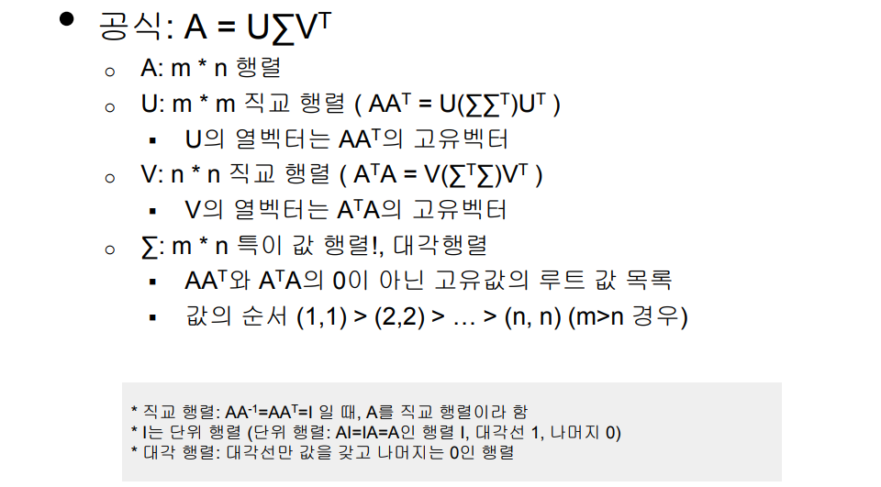
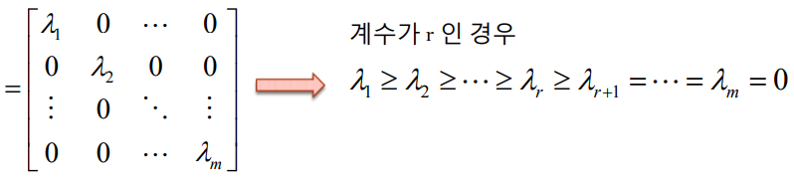
Method 1: Dimensionality Reduction on X
선형 대수학에서 행렬을 분해하는 방법 중 하나
∑

Slide 14
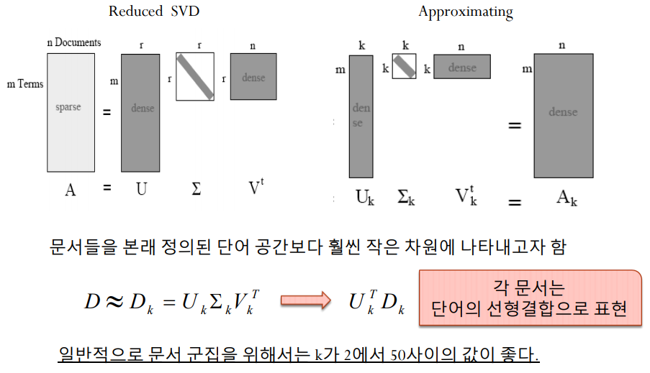
Method 1: Dimensionality Reduction on X

Slide 15
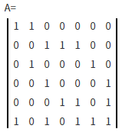
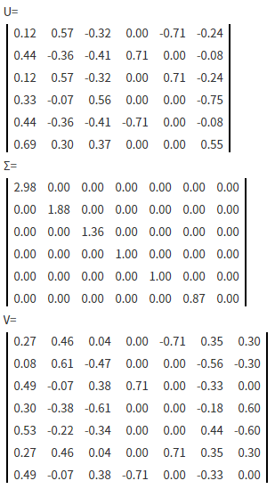
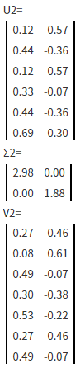
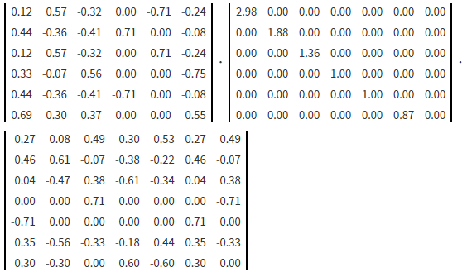
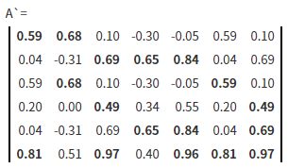
Method 1: Dimensionality Reduction on X

Slide 16
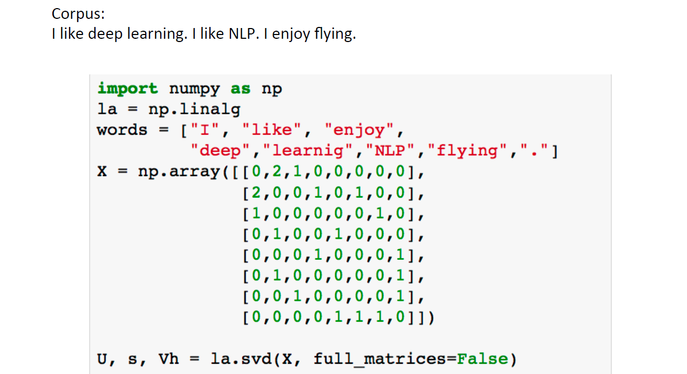
Simple SVD word vectors in Python

Slide 17
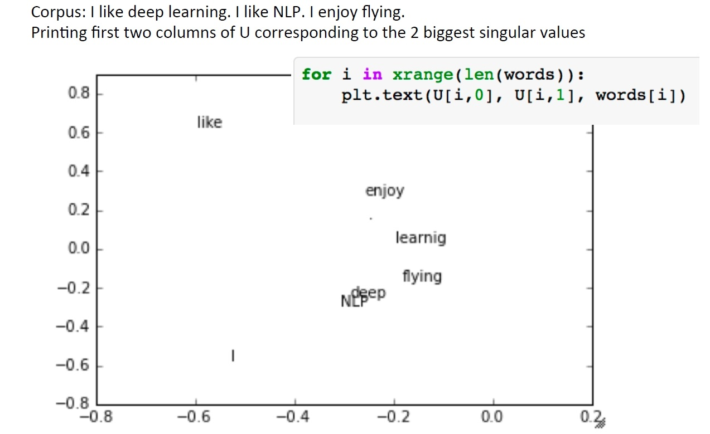
Simple SVD word vectors in Python

Slide 18
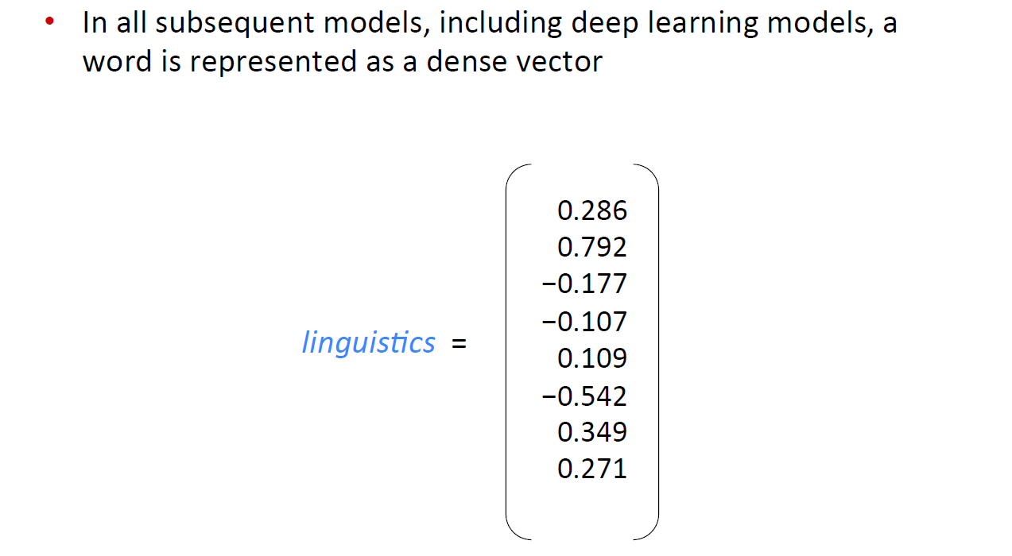
Word meaning is defined in terms of vectors

Slide 19
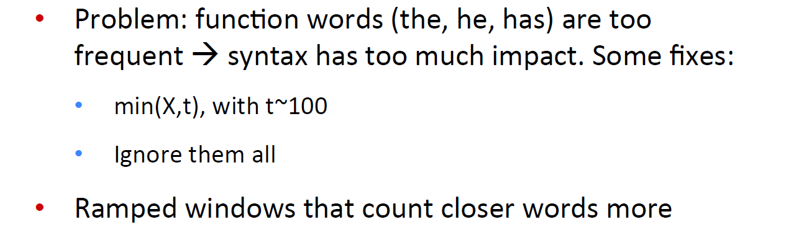
Hacks to X
i.e. weight the co-occurrence count based on distance between the words in the document

Slide 20
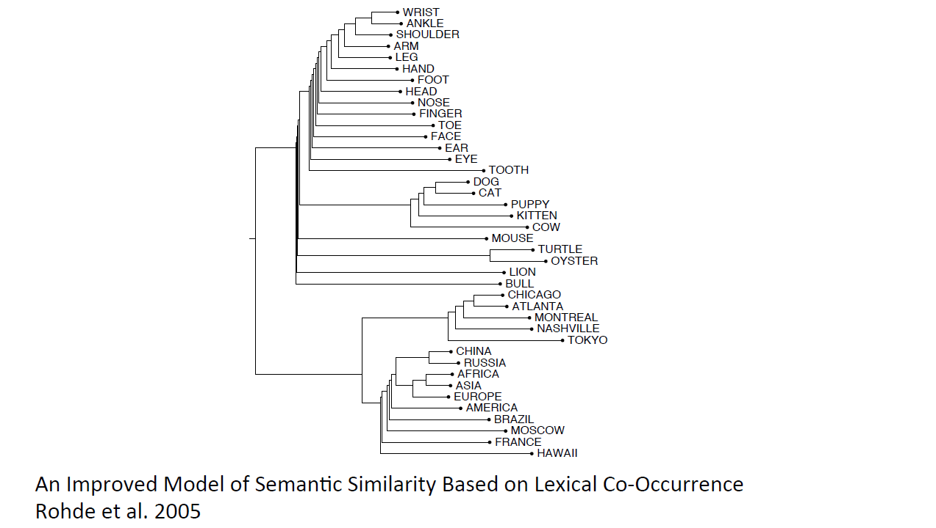
Interesting semantic patterns emerge in the vectors

Slide 21
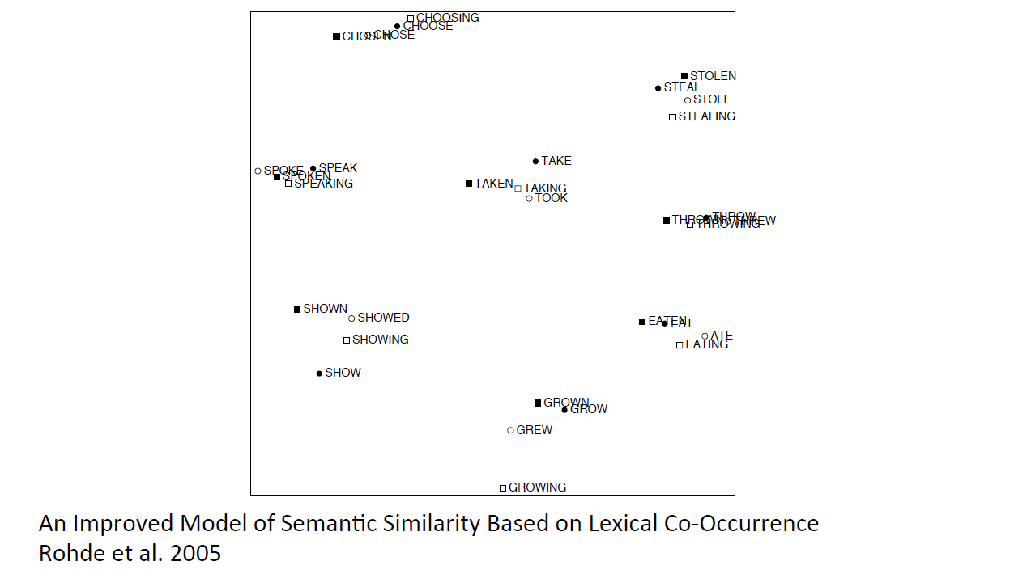
Interesting syntactic patterns emerge in the vectors

Slide 22
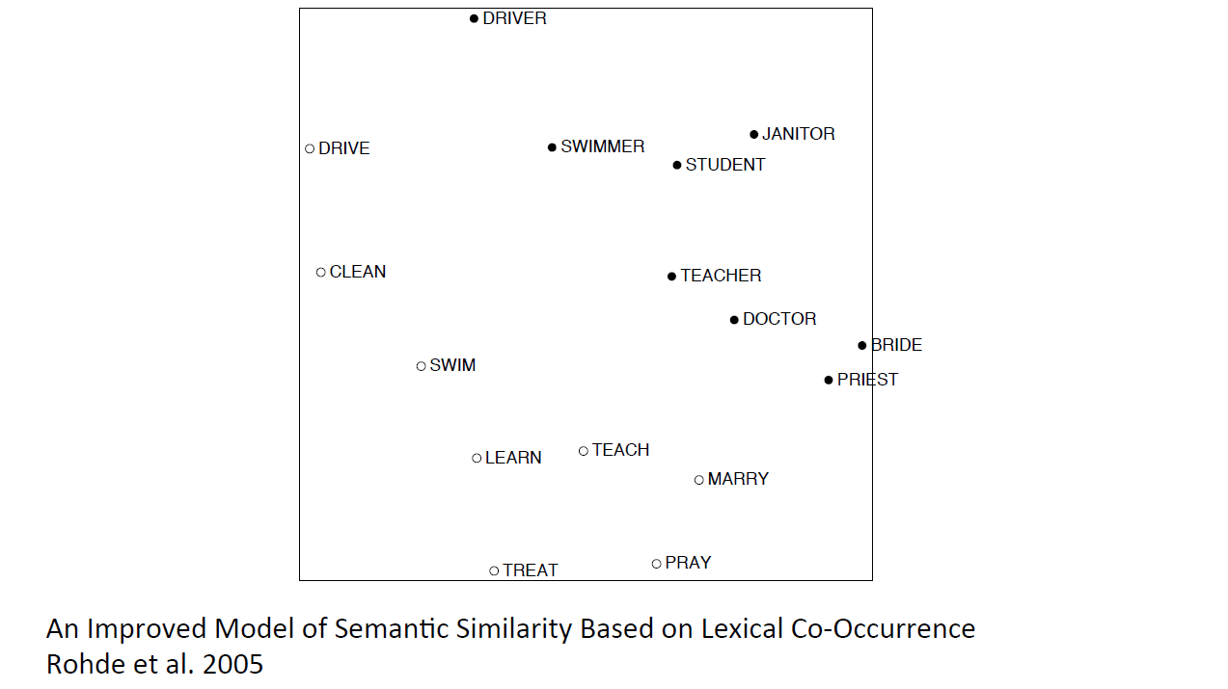
Interesting semantic patterns emerge in the vectors

Slide 23
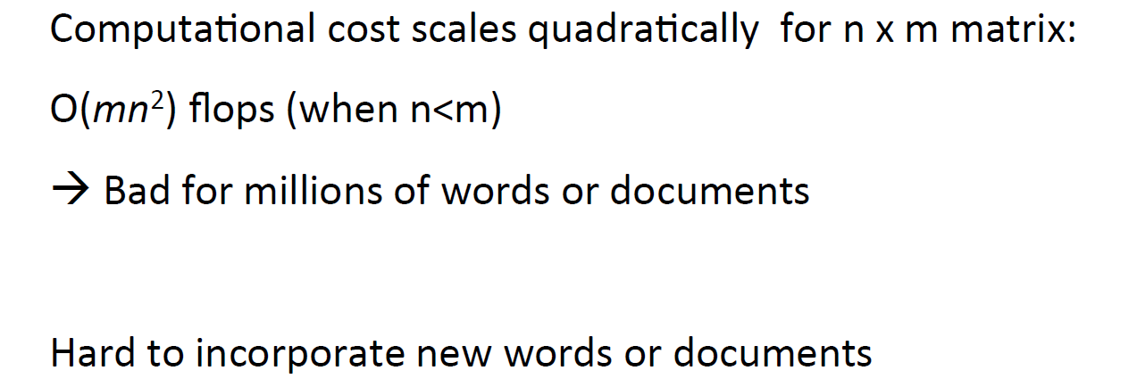
Problems with SVD

Slide 24
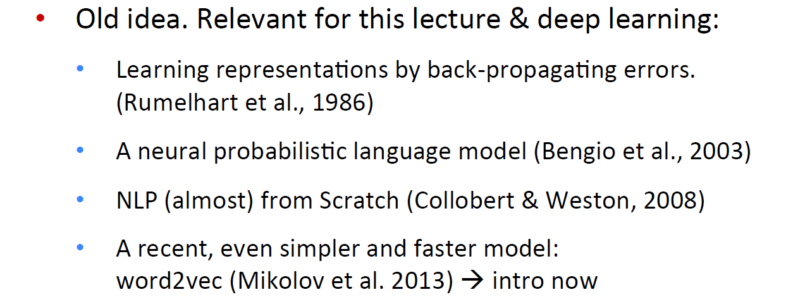
Idea: Directly learn low-dimensional word vectors

Slide 25
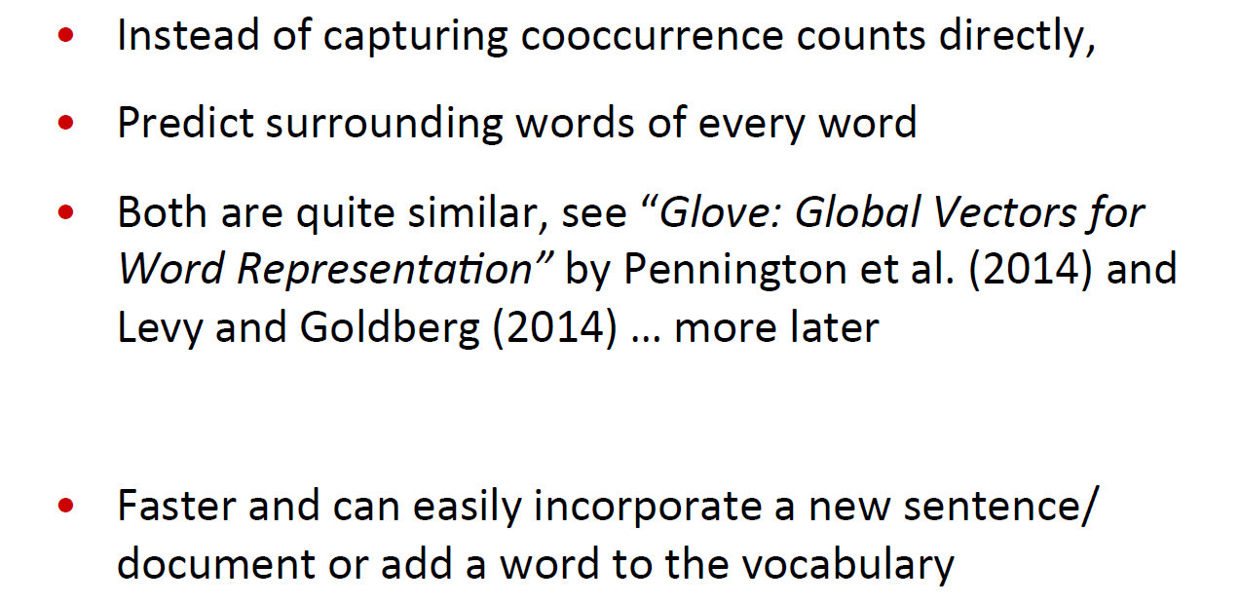
Main Idea of word2vec

Slide 26
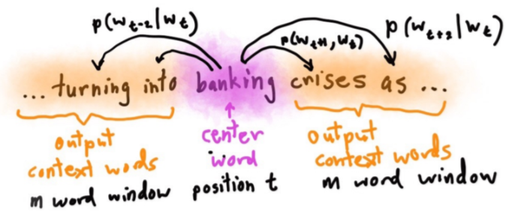
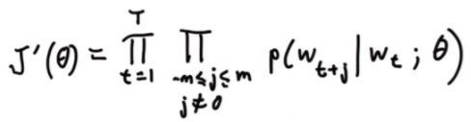
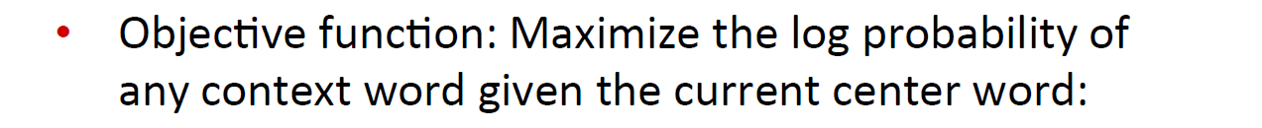
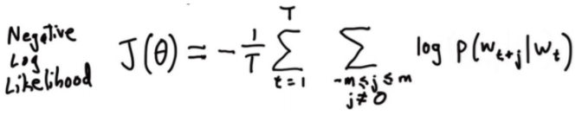
Details of Word2Vec

Slide 27
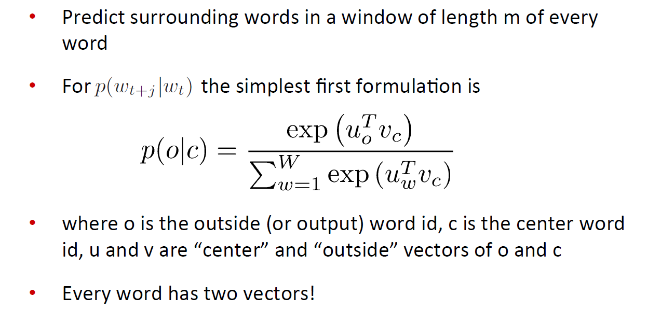
Details of Word2Vec

Slide 28
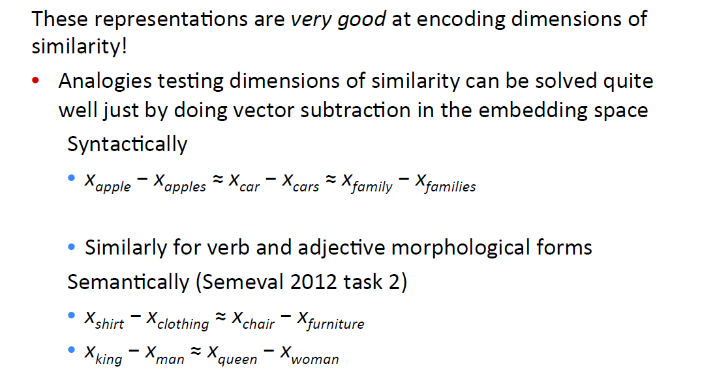
Linear Relationships in word2vec

Slide 29
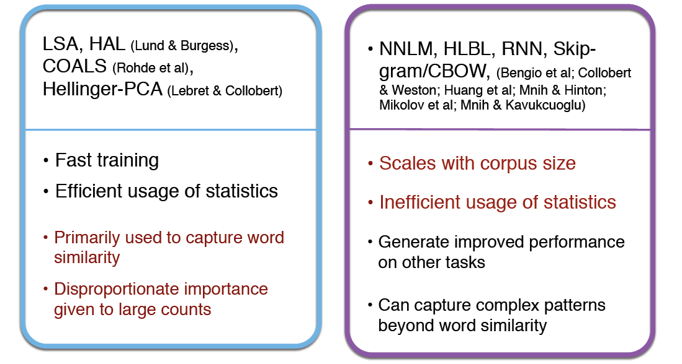
Count based vs direct prediction

Slide 30
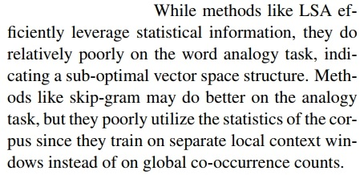
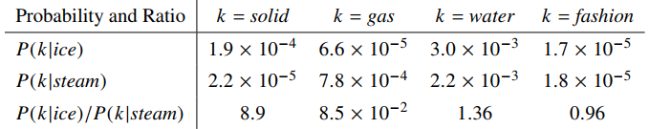
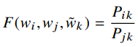
Combining the best of both worlds: GloVe

Slide 31
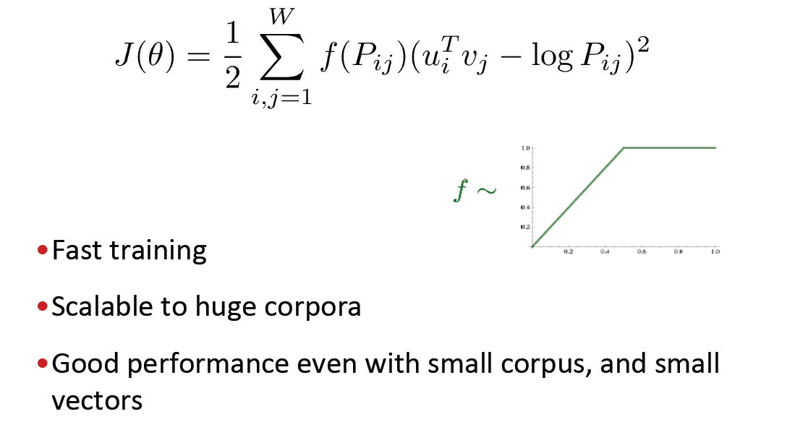
Combining the best of both worlds: GloVe
Their dot product equals the logarithm of the words’ probability of co-occurrence)

Slide 32
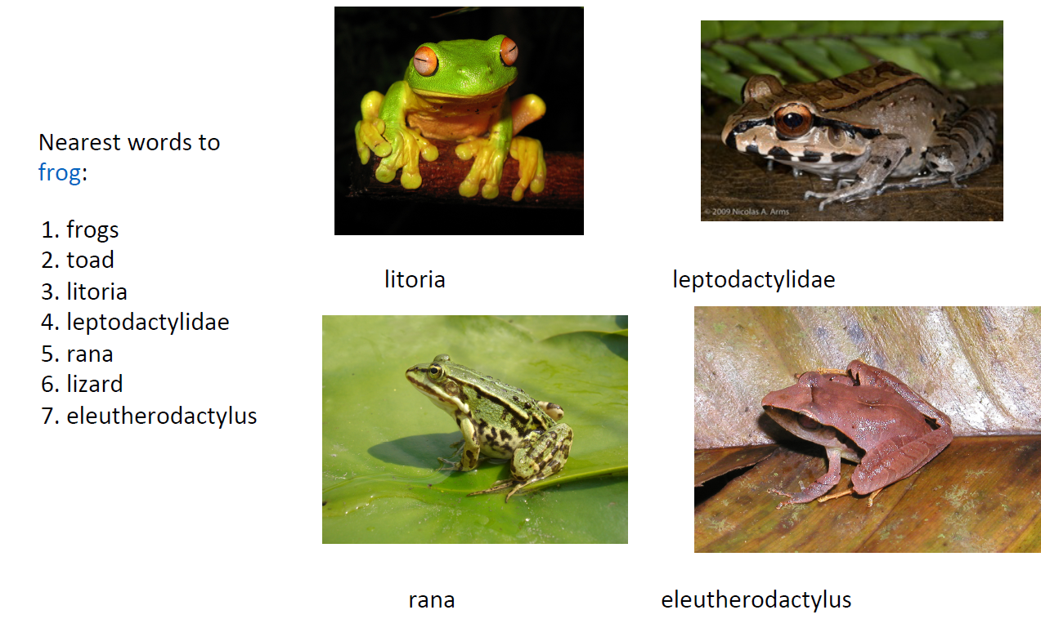
Glove results

Slide 33
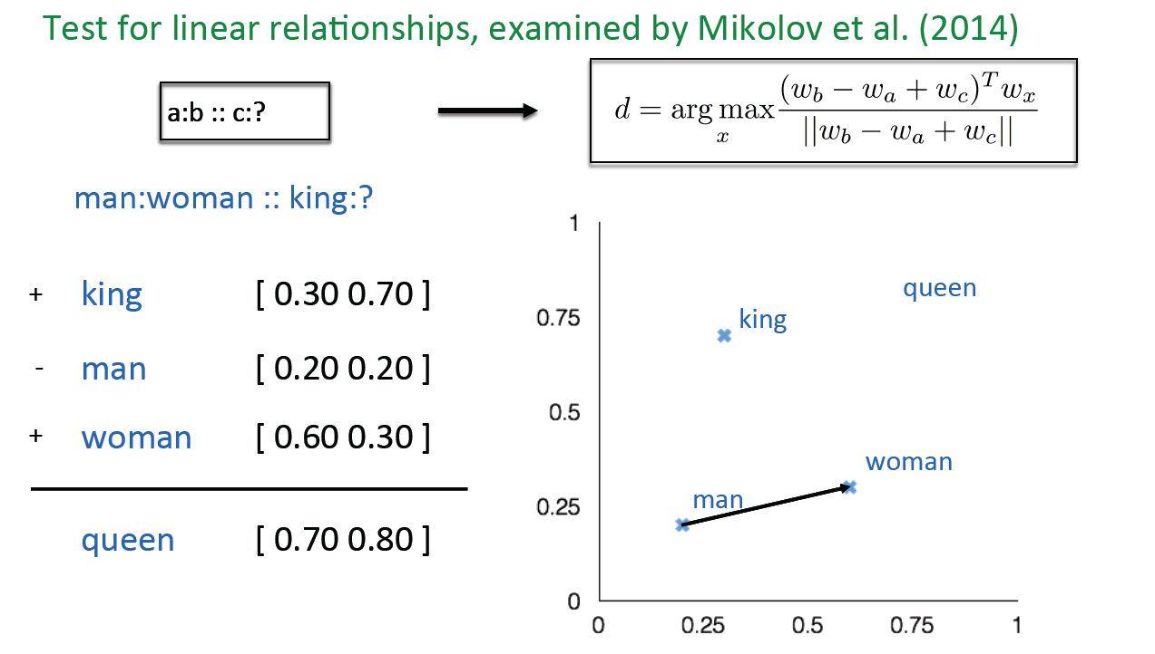
Word Analogies

Slide 34
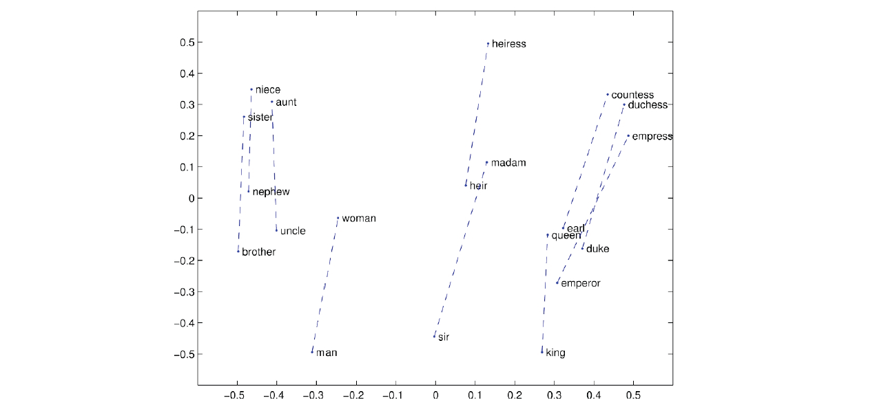
Glove Visualizations

Slide 35
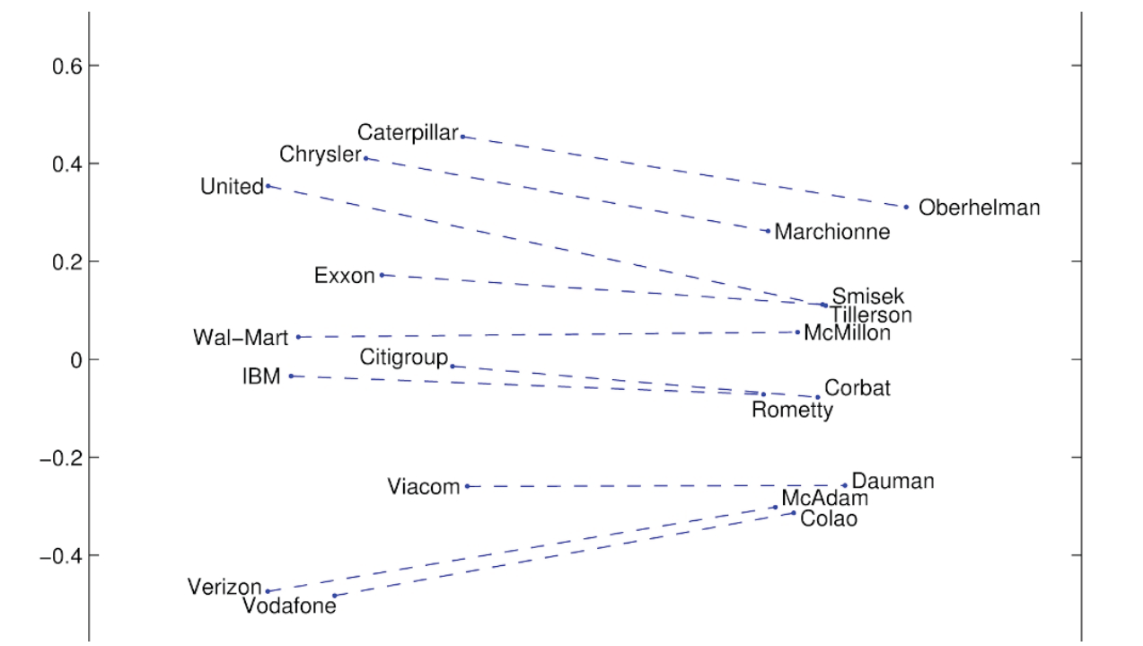
Glove Visualizations: Companly - CEO

Slide 36
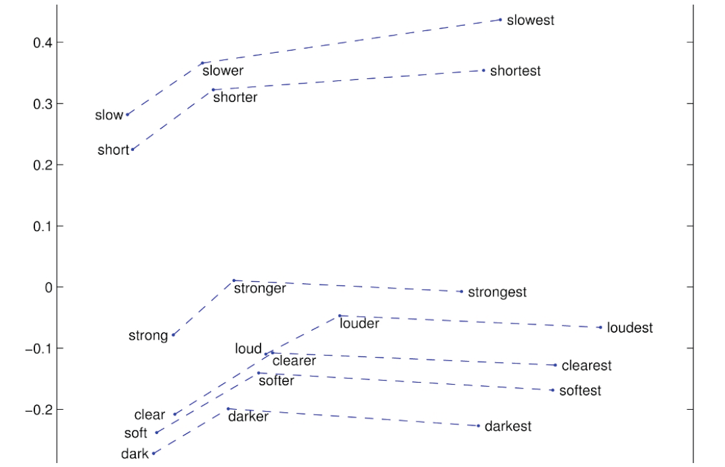
Glove Visualizations: Companly - CEO

Slide 37

감사합니다!
Q & A

